Slide 1
Module 1 Introduction to number theory and basic cryptography

Slide 2
Security Goals
Security Goals
Confidentiality
Integrity
Availability

Slide 3
Security Goals
Confidentiality
Confidentiality is equivalent to privacy, we need to protect our confidential information(s).
Confidentiality involves protection of information by providing access of information to allowed users and disallowing others.
Confidentiality can be achieved through:
1. Encryption
2. Access Control
3. Authentication
4. Authorization

Slide 4
Security Goals
Integrity
Integrity refers to ensuring that data is real, accurate and safeguarded from unauthorized user modification.
Integrity gives the assurance that the information received is exact and accurate.
Availability
Availability is the property in which information is accessible and modifiable in a timely fashion by those authorized to do so.
It is the guarantee of reliable and constant access to our sensitive data by authorized people.

Slide 5
Security Attacks
Confidentiality, Integrity and Availability which are the security goals can be threatened by security attacks.
The security attacks can be categorized in two ways.
1. Attacks on security goals
2. Two broad categories based on their effects on the system.
A. Passive Attack
B. Active Attack

Slide 6
Security Attacks
Security Attacks
Snooping
Modification
Denial of Service
Masquerading
Traffic Analysis
Threat to availability
Replaying
Threat to confidentiality
Repudiation
Threat to integrity

Slide 7
Security Attacks
Attacks Threatening Confidentiality
1. Snooping
Snooping is unauthorized access to data or interception of data.
2. Traffic Analysis
Traffic analysis refers to monitoring online traffic to obtain information.
It can be used to collect pairs of requests and responses to guess the nature of transaction.

Slide 8
Security Attacks
Attacks Threatening Integrity
1. Modification
After accessing the information, the attacker can modify or delete the information.
2. Masquerading
A masquerade attack is an attack that uses a fake identity, such as a network identity, to gain unauthorized access to personal computer information through legitimate access identification.
Masquerade attacks can be perpetrated using stolen passwords and log-ons, or by finding a way around the authentication process.

Slide 9
Security Attacks
3. Replaying
The attackers obtains a copy of a message sent by a user and later tries to replay it.
4. Repudiation
A repudiation attack happens when an application or system does not adopt controls to properly track and log users' actions, thus permitting malicious manipulation or forging the identification of new actions.
This attack is performed either by the sender or the receiver.

Slide 10
Security Attacks
Attacks Threatening Availability
1. Denial of Service
A Denial-of-Service (DoS) attack is an attack meant to shut down a machine or network, making it inaccessible to its intended users.
Buffer overflow attacks – the most common DoS attack.
The concept is to send more traffic to a network address than the programmers have built the system to handle.

Slide 11
Security Attacks
Passive Attack
In passive attack, the objective or goal of the attacker is to obtain the information. This means that the attacker or attack doesn’t modify data or harm the system.
Although passive attacks do not harm the system, the attack may harm the sender or the receiver of the message.
Passive attack can be a danger for the confidentiality of the message.
Passive attacks can be prevented by encipherment of the data.

Slide 12
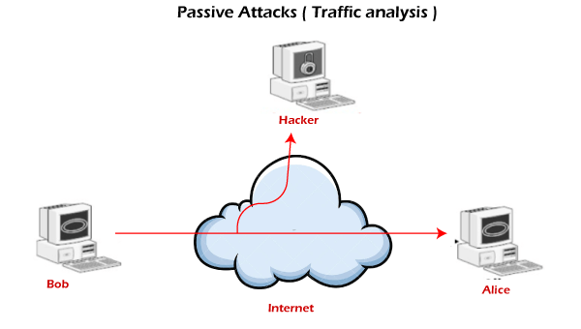
Security Attacks
Passive Attack

Slide 13
Security Attacks
Active Attack
An active attack, may change the data or harm the system.
Active attacks threaten the integrity and availability.
The system resources can be changed due to active attacks. So, the damage done with active attacks can be harmful to the system and its resources.

Slide 14
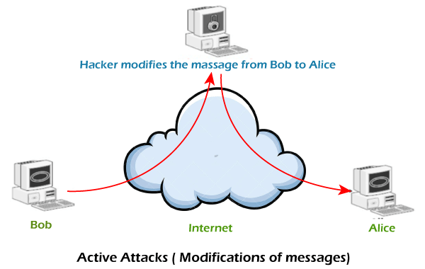
Security Attacks
Active Attack

Slide 15
Security Attacks
Categorizing passive and active attacks
Attacks | Passive / Active | Threatening
Snooping Traffic analysis | Passive | Confidentiality
Modification Masquerading Replaying Repudiation | Active | Integrity
Denial of Service | Active | Availability

Slide 16
Security Services
International Telecommunication Union – Telecommunication Standardization Sector (ITU-T) (X.800) has defined five services related to security goals and attacks.
Security Services
Data Confidentiality
Data Integrity
Authentication
Non-Repudiation
Access Control
Anti Change
Anti Replay
Peer entity
Data Origin
Proof of Origin
Proof of Delivery

Slide 17
Security Services
Data Confidentiality
Confidentiality is the fundamental security service provided by cryptography. It is a security service that keeps the information from an unauthorized person. It is sometimes referred to as privacy or secrecy.
The services defined by X.800 is very broad and encompasses confidentiality of whole message or part of message.
It prevents snooping and traffic analysis attack.

Slide 18
Security Services
Data Integrity
Data integrity is designed to protect data from modification, insertion, deletion and replaying by an adversary. It may protect the whole message or part of message.
Its assurance that data received are exactly as sent by an authorized entity.
Authentication
Authentication provides the identification of the originator. It confirms to the receiver that the data received has been sent only by an identified and verified sender.

Slide 19
Security Services
Non-Repudiation
It is a security service that ensures that an entity cannot refuse the ownership of a previous commitment or an action. It is an assurance that the original creator of the data cannot deny the creation or transmission of the said data to a recipient or third party.
Non-repudiation is a property that is most desirable in situations where there are chances of a dispute over the exchange of data.
Access Control
It provides protection against unauthorized access to data. It involves reading, writing, modifying, etc.

Slide 20
Security Mechanisms
ITU-T (X.800) also recommends some security mechanisms to provide the security services.
Encipherment
Data Integrity
Digital Signature
Security Mechanisms
Authentication Exchange
Traffic Padding
Routing Control
Notarization
Access Control

Slide 21
Security Mechanisms
Encipherment
Encipherment deals with hiding and covering of data which helps data to become confidential.
It is achieved by applying mathematical calculations or algorithms which reconstruct information into not readable form.
It is achieved by two famous techniques named Cryptography and Encipherment.
Level of data encryption is dependent on the algorithm used for encipherment.

Slide 22
Security Mechanisms
Data Integrity
Data integrity is used by appending value to data to which is created by data itself.
It is similar to sending packet of information known to both sending and receiving parties and checked before and after data is received.
When this packet or data which is appended is checked and is the same while sending and receiving data integrity is maintained.

Slide 23
Security Mechanisms
Digital Signature
A digital signature is a means by which the sender can electronically sign the data and the receiver can electronically verify the signature.
The sender uses a process that involves showing that she owns a private key related to the public key that she has announced publicly.
The receiver uses the sender’s public key to prove that the message is indeed signed by the sender who claims to be have sent the message.

Slide 24
Security Mechanisms
Authentication Exchange
In authentication exchange, two entities exchange some messages to prove their identity to each other.
This is achieved at the TCP/IP layer where two-way handshaking mechanism is used to ensure data is sent or not.
Traffic Padding
It means inserting some bogus data into the data traffic to thwart the adversary attempt to use traffic analysis.

Slide 25
Security Mechanisms
Routing Control
It means selecting and continuously changing different available routes between the sender and the receiver to prevent the opponent from eavesdropping on a particular route.
Notarization
It involves use of trusted third party in communication. It acts as mediator between sender and receiver so that if any chance of conflict is reduced. This mediator keeps record of requests made by sender to receiver for later denied.

Slide 26
Security Mechanisms
Access Control
This mechanism is used to stop unintended access to data which you are sending. It can be achieved by various techniques such as applying passwords, using firewall, or just by adding PIN to data.

Slide 27
Relation between Services and Mechanisms
Security Service | Security Mechanism
Data confidentiality | Encipherment, routing control
Data integrity | Encipherment, digital signature, data integrity
Authentication | Encipherment, digital signature, authentication exchange
Nonrepudiation | Digital signature, data integrity, notarization
Access control | Access control

Slide 28
Security Techniques
Cryptography
Cryptography is technique of securing information and communications through use of codes so that only those person for whom the information is intended can understand it and process it. Thus preventing unauthorized access to information.
The prefix “crypt” means “hidden” and suffix graphy means “writing”.
Cryptography mechanisms:
1. Symmetric Key Encipherment
2. Asymmetric Key Encipherment
3. Hashing

Slide 29
Security Techniques
Symmetric Key Encipherment
It is an encryption system where the sender and receiver of message use a single common key to encrypt and decrypt messages.
Symmetric Key encipherment uses a single secret key for both encryption and decryption.
Encryption/decryption can be thought of as an electronic locking.
Symmetric Key Systems are faster and simpler but the problem is that sender and receiver have to somehow exchange key in a secure manner.
The most popular symmetric key cryptography system is Data Encryption System(DES).

Slide 30
Security Techniques
Asymmetric Key Encipherment
Under this system a pair of keys is used to encrypt and decrypt information. A public key is used for encryption and a private key is used for decryption. Public key and Private Key are different.
Even if the public key is known by everyone the intended receiver can only decode it because he alone knows the private key.

Slide 31
Security Techniques
Hashing
There is no usage of any key in this algorithm. A hash value with fixed length is calculated as per the plain text which makes it impossible for contents of plain text to be recovered.
Many operating systems use hash functions to encrypt passwords.

Slide 32
Security Techniques
Steganography
The word steganography, with origin in Greek, means “covered writing”. Cryptography means concealing the contents of a message by enciphering; steganography means concealing the message itself by covering it with something else.

Slide 33
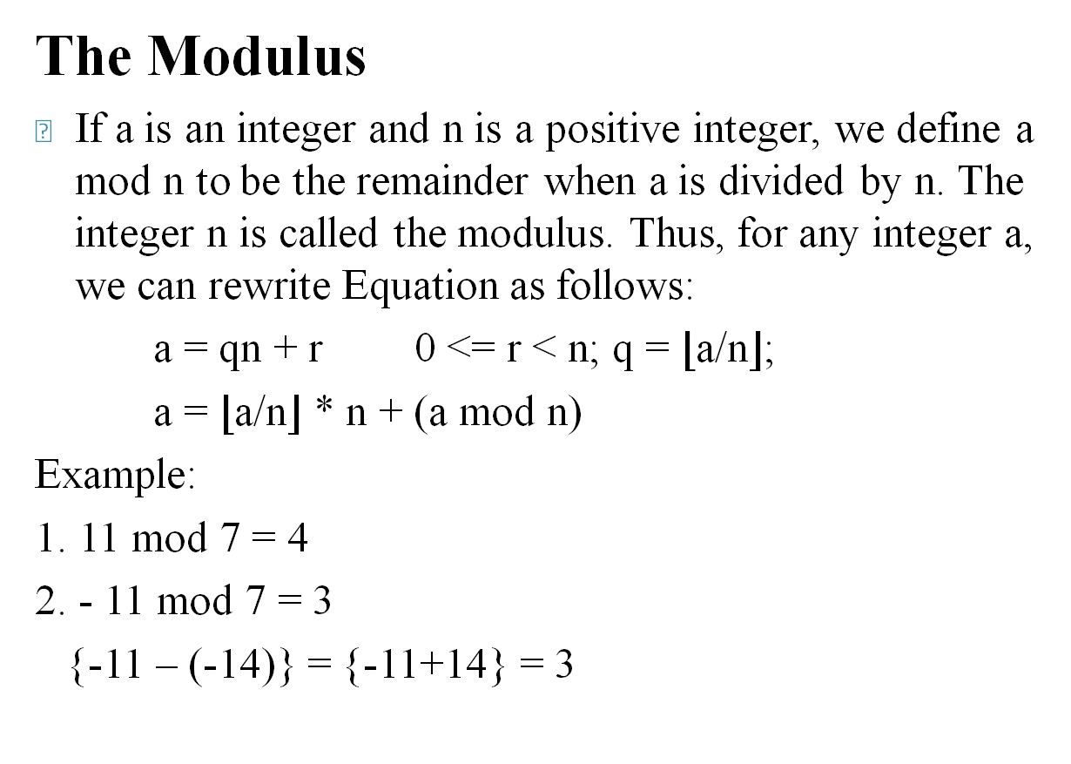
Modular Arithmetic
The Modulus
If a is an integer and n is a positive integer, we define a mod n to be the remainder when a is divided by n. The integer n is called the modulus. Thus, for any integer a, we can rewrite Equation as follows:
a = qn + r 0 <= r < n; q = $⌊\text{a}\text{/}\text{n}⌋$;
a = $⌊\text{a}\text{/}\text{n}⌋$ * n + (a mod n)
Example:
1. 11 mod 7 = 4
2. - 11 mod 7 = 3
{-11 – (-14)} = {-11+14} = 3

Slide 34
Modular Arithmetic
The Modulus
Two integers a and b are said to be congruent modulo n, if (a mod n) = (b mod n). This is written as a ≡ b (mod n)
Example:
1. 73 ≡ 4 (mod 23)
73 mod 23 ≡ 4 mod 23
4 ≡ 4
2. 21 ≡ -9 (mod 10)
21 mod 10 ≡ -9 mod 10
1 ≡ 1
Note that if a ≡ 0 (mod n), then n | a.

Slide 35
Modular Arithmetic
Properties of Congruences
1. a ≡ b (mod n) if n | (a - b).
2. a ≡ b (mod n) implies b ≡ a (mod n).
3. a ≡ b (mod n) and b ≡ c (mod n) imply a ≡ c (mod n).
To demonstrate the first point, if n | (a - b), then (a - b) = kn for some k. So we can write a = b + kn. Therefore, (a mod n) = (remainder when b + kn is divided by n) = (remainder when b is divided by n) = (b mod n).
23 ≡ 8 (mod 5) because 23 - 8 = 15 = 3 * 5
-11 ≡ 5 (mod 8) because -11 - 5 = -16 = (-2) * 8 81 ≡ 0 (mod27) because 81 - 0 = 81 = 3 * 27

Slide 36
Modular Arithmetic
Modular Arithmetic Opertations
1. (a + b) mod n = [(a mod n) + (b mod n)] mod n
2. (a - b) mod n = [(a mod n) - (b mod n)] mod n
3. (a * b) mod n = [(a mod n) * (b mod n)] mod n
Demonstration of first property.
Define (a mod n) = r_{a} and (b mod n) = r_{b}. Then we can write a = r_{a} + jn for some integer j and b = r_{b} + kn for some integer k. Then
(a + b) mod n = (r_{a} + jn + r_{b} + kn) mod n
= (r_{a} + r_{b} + (k + j)n) mod n
= (r_{a} + r_{b}) mod n
= [(a mod n) + (b mod n)] mod n

Slide 37
Modular Arithmetic
Examples
1. (11 + 15) mod 8 = [(11 mod 8) + (15 mod 8)] mod 8
= [(3 + 7)] mod 8 = 10 mod 8 = 2
(11 + 15) mod 8 = 26 mod 8 = 2
2. (11 - 15) mod 8
= [(11 mod 8) - (15 mod 8)] mod 8
= [(3 - 7)] mod 8 = -4 mod 8 = 4
= -4-(-8) = -4 +8 = 4
(11 - 15) mod 8 = -4 mod 8 = 4
3. (11 * 15) mod 8 = [(11 mod 8) * (15 mod 8)] mod 8
= [(3 * 7)] mod 8 = 21 mod 8 = 5
(11 * 15) mod 8 = 165 mod 8 = 5

Slide 38
Modular Arithmetic
Properties of Modular Arithmetic
Define the set Z_{n} as the set of nonnegative integers less than n:
Z_{n} = {0, 1, … , (n - 1)}
This is referred to as the set of residues, or residue classes (mod n). To be more precise, each integer in Z_{n} represents a residue class. We can label the residue classes (mod n) as[0], [1], [2], … , [n - 1], where
[r] = {a: a is an integer, a ≡ r (mod n)}
Of all the integers in a residue class, the smallest nonnegative integer is the one used to represent the residue class.

Slide 39
Modular Arithmetic
Properties of Modular Arithmetic
Example:
The residue classes (mod 4) are
[0] = {…, -16, -12, -8, -4, 0, 4, 8, 12, 16, …}
[1] = {…, -15, -11, -7, -3, 1, 5, 9, 13, 17, …}
[2] = {…, -14, -10, -6, -2, 2, 6, 10, 14, 18, …}
[3] = {…, -13, -9, -5, -1, 3, 7, 11, 15, 19, …}
Q. The residue classes (mod 6) are ?
[0] = {…, -24, -18, -12, -6, 0, 6, 12, 18, 24, …}
[1] = {…, -23, -17, -11, -5, 1, 7, 13, 19, 25, …}
[2] = {…, -22, -16, -10, -4, 2, 8, 14, 20, 26, …}
[3] = {…, -21, -15, -9, -3, 3, 9, 15, 21, 27, …}
[4] = {…, -20, -14, -8, -2, 4, 10, 16, 22, 28, …}
[5] = {…, -19, -13, -7, -1, 5, 11, 17, 23, 29, …}

Slide 40
Modular Arithmetic
Properties of Modular Arithmetic
Property | Expression
Commutative Laws | (w + x) mod n = (x + w) mod n (w * x) mod n = (x * w) mod n
Associative Laws | [(w + x) + y]mod n=[w + (x + y)]mod n [(w * x) * y]mod n=[w * (x * y)] mod n
Distributive Laws | [w * (x + y)] mod n = [(w * x) + (w * y)] mod n
Identities | (0 + w) mod n = w mod n (1 * w) mod n = w mod n
Additive Inverse | For each w ∈ Z_{n}, there exists a z such that w + z ≡ 0 mod n

Slide 41
Euclidean Algorithm
One of the basic techniques of number theory is the Euclidean algorithm, which is a simple procedure for determining the greatest common divisor of two positive integers. First, we need a simple definition: Two integers are relatively prime if their only common positive integer factor is 1.

Slide 42
Euclidean Algorithm
Greatest Common Divisor
Recall that nonzero b is defined to be a divisor of a if a = m * b for some m, where a, b, and m are integers. We will use the notation gcd(a, b) to mean the greatest common divisor of a and b. The greatest common divisor of a and b is the largest integer that divides both a and b. We also define gcd(0, 0) = 0.
More formally, the positive integer c is said to be the greatest common divisor of a and b if
1. c is a divisor of a and of b.
2. Any divisor of a and b is a divisor of c.
An equivalent definition is the following:
gcd(a, b) = max[k, such that k|a and k|b]

Slide 43
Euclidean Algorithm
Greatest Common Divisor
Because we require that the greatest common divisor be positive, gcd(a, b) = gcd(a, -b) = gcd(-a, b) = gcd(-a,-b). In general, gcd(a, b) = gcd(a , b).
gcd(60, 24) = gcd(60, -24) = 12
Also, because all nonzero integers divide 0, we have gcd(a, 0) = a .
We stated that two integers a and b are relatively prime if their only common positive integer factor is 1. This is equivalent to saying that a and b are relatively prime if gcd(a, b) = 1.
8 and 15 are relatively prime because the positive divisors of 8 are 1, 2, 4, and 8, and the positive divisors of 15 are 1, 3, 5, and 15. So 1 is the only integer on both lists.

Slide 44
Euclidean Algorithm
Finding the Greatest Common Divisor
We now describe an algorithm credited to Euclid for easily finding the greatest common divisor of two integers.
Suppose we have integers a, b such that d = gcd(a, b). Because gcd(|a| , |b|) = gcd(a, b), there is no harm in assuming a >= b > 0. Now dividing a by b and applying the division algorithm, we can state:
a = q₁b + r₁ 0 <= r₁ < b
If it happens that r₁ = 0, then b|a and d = gcd(a, b) = b. But if r₁ ≠ 0, we can state that d|r₁.

Slide 45
Euclidean Algorithm
Finding the Greatest Common Divisor
Assuming that r₁ ≠ 0. Because b > r₁, we can divide b by r₁ and apply the division algorithm to obtain:
b = q₂r₁ + r₂ 0 <= r₂ < r₁
As before, if r₂ = 0, then d = r₁ and if r₂ ≠ 0, then d = gcd(r₁, r₂).
The division process continues until some zero remainder appears, say, at the (n + 1)th stage where r_{n-1} is divided by r_{n}. The result is the following system of equations:

Slide 46
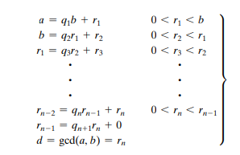
Euclidean Algorithm
Finding the Greatest Common Divisor
At each iteration, we have d = gcd(r_{i} , r_{I+1}) until finally d = gcd(r_{n}, 0) = r_{n}. Thus, we can find the greatest common divisor of two integers by repetitive application of the division algorithm. This scheme is known as the Euclidean algorithm.

Slide 47
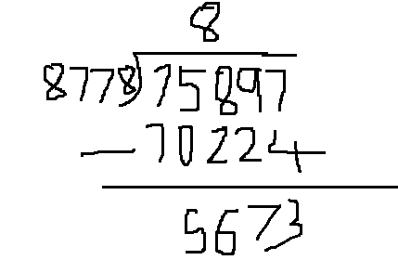
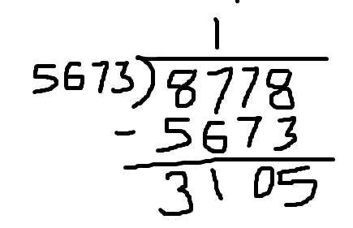
Euclidean Algorithm
Example: Find d = gcd(a,b) = gcd(75897, 8778)
q₁
a = q₁b + r₁
75897 = q₁ * 8778 + r₁
75897 = 8 * 8778 + 5673
d = gcd(8778,5673)
r₁
b = q₂r₁ + r₂
8778 = q₂ * 5673 + r₂
q₂
8778 = 1 * 5673 + 3105
d = gcd(5673,3105)
r₂
r₁ = q₃r₂ + r₃
5673 = q₃ * 3105 + r₃
d = gcd(3105,2568)
5673 = 1 * 3105 + 2568
r₂ = q₄r₃ + r₄
3105 = 1 * 2568 + 537
d = gcd(2568,537)
3105 = 1 * 2568 + 537

Slide 48
Euclidean Algorithm
Example: Find d = gcd(a,b) = gcd(75897, 8778)
a = q₁b + r₁ | 75897 = 8 * 8778 + 5673 | d = gcd(8778,5673)
b = q₂r₁ + r₂ | 8778 = 1 * 5673 + 3105 | d = gcd(5673,3105)
r₁ = q₃r₂ + r₃ | 5673 = 1 * 3105 + 2568 | d = gcd(3105,2568)
r₂ = q₄r₃ + r₄ | 3105 = 1 * 2568 + 537 | d = gcd(2568,537)
r₃ = q₅r₄ + r₅ | 2568= 4 * 537 + 420 | d = gcd(537,420)
r₄ = q₆r₅ + r₆ | 537 = 1 * 420 + 117 | d = gcd(420,117)
r₅ = q₇r₆ + r₇ | 420 = 3 * 117 + 69 | d = gcd(117,69)
r₆ = q₈r₇ + r₈ | 117 = 1 * 69 + 48 | d = gcd(69,48)
r₇ = q₉r₈ + r₉ | 69 = 1 * 48 + 21 | d = gcd(48,21)
r₈ = q₁₀r₉ + r₁₀ | 48 = 2 * 21 + 6 | d = gcd(21,6)
r₉ = q₁₁r₁₀+r₁₁ | 21 = 3 * 6 + 3 | d = gcd(6,3)
r₁₀ =q₁₂r₁₁+r₁₂ | 6 = 2 * 3 + 0 | d = gcd(3,0) = 3
GCD

Slide 49
Euclidean Algorithm
Dividend | Divisor | Quotient | Remainder
a = 75897 | b = 8778 | q₁ = 8 | r₁ = 5673
b = 8778 | r₁ = 5673 | q₂ = 1 | r₂ = 3105
r₁ = 5673 | r₂ = 3105 | q₃ = 1 | r₃ = 2568
r₂ = 3105 | r₃ = 2568 | q₄ = 1 | r₄ = 537
r₃ = 2568 | r₄ = 537 | q₅ = 4 | r₅ = 420
r₄ = 537 | r₅ = 420 | q₆ = 1 | r₆ = 117
r₅ = 420 | r₆ = 117 | q₇ = 3 | r₇ = 69
r₆ = 117 | r₇ = 69 | q₈ = 1 | r₈ = 48
r₇ = 69 | r₈ = 48 | q₉ = 1 | r₉ = 21
r₈ = 48 | r₉ = 21 | q₁₀ = 2 | r₁₀ = 6
r₉ = 21 | r₁₀ = 6 | q₁₁ = 3 | r₁₁ = 3
r₁₀ = 6 | r₁₁ = 3 | q₁₂ = 2 | r₁₂ = 0
GCD

Slide 50
Euclidean Algorithm
q | r₁ | r₂ | r
8 | 75897 | 8778 | 5673
1 | 8778 | 5673 | 3105
1 | 5673 | 3105 | 2568
1 | 3105 | 2568 | 537
4 | 2568 | 537 | 420
1 | 537 | 420 | 117
3 | 420 | 117 | 69
1 | 117 | 69 | 48
1 | 69 | 48 | 21
2 | 48 | 21 | 6
3 | 21 | 6 | 3
2 | 6 | 3 | 0
 | 3 | 0
GCD

Slide 51
Euclidean Algorithm
Question: Find the gcd of (3768, 1701)
q | r₁ | r₂ | r
2 | 3768 | 1701 | 366
4 | 1701 | 366 | 237
1 | 366 | 237 | 129
1 | 237 | 129 | 108
1 | 129 | 108 | 21
5 | 108 | 21 | 3
7 | 21 | 3 | 0
 | 3 | 0 | 0
GCD

Slide 52
Extended Euclidean Algorithm
We now proceed to look at an extension to the Euclidean algorithm that will be important for later computations in the area of finite fields and in encryption algorithms, such as RSA.
For given integers a and b, the extended Euclidean algorithm not only calculate the greatest common divisor d but also two additional integers x and y that satisfy the following equation.
ax + by = d = gcd(a, b)
It should be clear that x and y will have opposite signs.

Slide 53
Extended Euclidean Algorithm
Finding values of x and y
When i = -1, x₋₁ = 1; y₋₁ = 0
i = 0, x₀ = 0; y₀ = 1
i = 1, x₁ = x₋₁ - q₁x₀ ; y₁ = y₋₁ - q₁y₀
i = 2, x₂ = x₀ – q₂x₁ ; y₂ = y₀ – q₂y₁
i = 3, x₃ = x₁ – q₃x₂ ; y₃ = y₁ – q₃y₂
.
.
.
i = n, x_{n} = x_{n-2} – q_{n}x_{n-1} ; y_{n} = y_{n-2} – q_{n}y_{n-1}

Slide 54
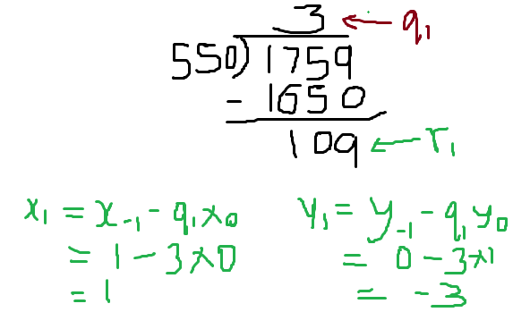
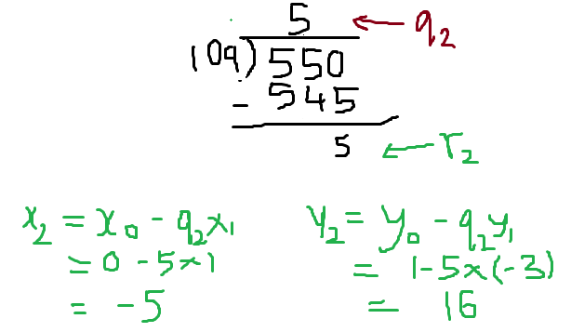
Extended Euclidean Algorithm
First-Way : As an example, let us use a = 1759 and b = 550 and solve for 1759x + 550y = gcd(1759, 550).
i | r_{i} | q_{i} | x_{i} | y_{i}
-1 | 1759 | - | 1 | 0
0 | 550 | - | 0 | 1
1 | 109 | 3 | 1-3*0 = 1 | 0-3*1 = -3
2 | 5 | 5 | 0-5*1 = -5 | 1-5*(-3) = 16

Slide 55
Extended Euclidean Algorithm
The results are shown in Table 4.4.
Result: d = 1; x = -111; y = 355
Thus, we have 1759 * (-111) + 550 * 355= -195249 + 195250 = 1.
i | r_{i} | q_{i} | x_{i} | y_{i}
-1 | 1759 | - | 1 | 0
0 | 550 | - | 0 | 1
1 | 109 | 3 | 1-3*0 = 1 | 0-3*1 = -3
2 | 5 | 5 | 0-5*1 = -5 | 1-5*(-3) = 16
3 | 4 | 21 | 1-21*(-5) = 106 | -3-21*16 = -339
4 | 1 | 1 | -5-1*106 = -111 | 16-1*(-339) = 355
5 | 0 | 4

Slide 56
Extended Euclidean Algorithm
Second-Way :
s = s₁ – qs₂ ; t = t₁ – qt₂
q | r₁ | r₂ | r | s₁ | s₂ | s | t₁ | t₂ | t
3 | 1759 | 550 | 109 | 1 | 0 | 1 | 0 | 1 | -3
5 | 550 | 109 | 5 | 0 | 1 | -5 | 1 | -3 | 16
21 | 109 | 5 | 4 | 1 | -5 | 106 | -3 | 16 | -339
1 | 5 | 4 | 1 | -5 | 106 | -111 | 16 | -339 | 355
4 | 4 | 1 | 0 | 106 | -111 | 550 | -339 | 355 | -1759
 | 1 | 0 |  | -111 | 550 |  | 355 | -1759
GCD
s
t

Slide 57
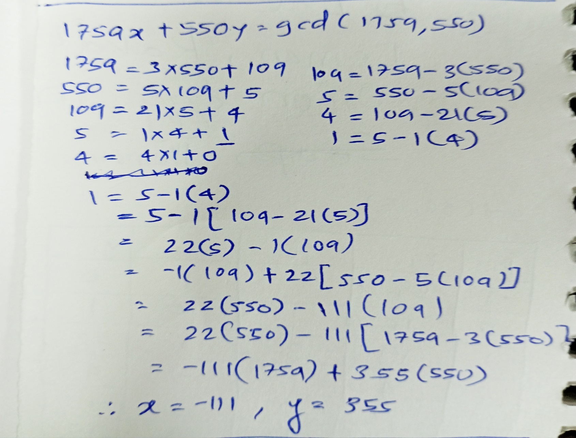
Extended Euclidean Algorithm
Third-Way :

Slide 58
Extended Euclidean Algorithm
As an example, let us use a = 1914 and b = 899 and solve for 1914x + 899y = gcd(1914, 899).
Result: d = 29; x = 8; y = -17
Thus, we have 1914 * 8 + 899 * (-17) = 15312 - 15283 = 29.
i | r_{i} | q_{i} | x_{i} | y_{i}
-1 | 1914 | - | 1 | 0
0 | 899 | - | 0 | 1
1 | 116 | 2 | 1-2*0 = 1 | 0-2*1 = -2
2 | 87 | 7 | 0-7*1 = -7 | 1-7*(-2) = 15
3 | 29 | 1 | 1-1*(-7) = 8 | -2-1*15 = -17
4 | 0 | 3

Slide 59
Extended Euclidean Algorithm
q | r₁ | r₂ | r | s₁ | s₂ | s | t₁ | t₂ | t
2 | 1914 | 899 | 116 | 1 | 0 | 1 | 0 | 1 | -2
7 | 899 | 116 | 87 | 0 | 1 | -7 | 1 | -2 | 15
1 | 116 | 87 | 29 | 1 | -7 | 8 | -2 | 15 | -17
3 | 87 | 29 | 0 | -7 | 8 | -31 | 15 | -17 | 60
 | 29 | 0 |  | 8 | -31 |  | -17 | 60 | -1759

Slide 60
Extended Euclidean Algorithm
Extended Euclidean Algorithm can also be to calculate Multiplicative Inverse.
A multiplicative inverse or reciprocal for a number x, denoted by 1/x or x⁻¹, is a number which when multiplied by x yields the multiplicative identity, 1.
The multiplicative inverse of a fraction a/b is b/a.
Example : 3 mod 17
3 * ≡ 1 mod 17
3⁻¹
Note: We can only compute or find the multiplicate inverse when the gcd(a,b) = 1, or the numbers are relatively prime.

Slide 61
Extended Euclidean Algorithm
Example: Multiplicative inverse of 23 in Z₁₀₀
q | r₁ | r₂ | r | t₁ | t₂ | t
4 | 100 | 23 | 8 | 0 | 1 | -4
2 | 23 | 8 | 7 | 1 | -4 | 9
1 | 8 | 7 | 1 | -4 | 9 | -13
7 | 7 | 1 | 0 | 9 | -13 | 100
 | 1 | 0 |  | -13 | 100
GCD
M.I.
OR M.I. = -13 +100 = 87

Slide 62
Extended Euclidean Algorithm
Example: Calculate Multiplicative inverse for 17⁻¹ in Z₄₃
q | r₁ | r₂ | r | t₁ | t₂ | t
2 | 43 | 17 | 9 | 0 | 1 | -2
1 | 17 | 9 | 8 | 1 | -2 | 3
1 | 9 | 8 | 1 | -2 | 3 | -5
8 | 8 | 1 | 0 | 3 | -5 | 43
 | 1 | 0 |  | -5 | 43
GCD
M.I.
OR M.I. = -5 +43 = 38

Slide 63
Fermat’s Theorem
If ‘p’ is prime and ‘a’ is an integer not divisible by ‘p’ then
NOTE: 1. The first form of the theorem [Equation (8.2)] requires that a be relatively prime to p, but this form does not.
2. This theorem is also known as Fermat’s Little Theorem.
a^{p-1} ≡ 1 (mod p)
If ‘p’ is prime and ‘a’ is a positive integer, then
a^{p} ≡ a (mod p)

Slide 64
Fermat’s Theorem
Proof:
Consider the set of positive integers less than p: {1, 2, …, p-1} and multiply each element by a, modulo p, to get the set
X = {a mod p, 2a mod p, …, (p-1)a mod p}
None of the elements of X is equal to zero because p does not divide a.
Multiplying the numbers in both sets (p and X) and taking the result mod ‘p’ yields
a * 2a * … * (p-1)a ≡ [(1 * 2 * … * (p-1)](mod p) a^{p-1} (p -1)! ≡ (p-1)!(mod p)
Thus on equating (p-1)! term from both the sides, since it is relatively prime to p,
a^{p-1} ≡ 1 (mod p)

Slide 65
Euler’s Totient Function
Euler’s totient function, written ɸ(n), and defined as the number of positive integers less than n and relatively prime to n. By convention, ɸ(1) = 1.
It should be clear that, for a prime number p,
ɸ(p) = p – 1
Determine ɸ(37) and ɸ(35).
Because 37 is prime, all of the positive integers from 1 through 36 are relatively prime to 37. Thus ɸ(37) = 36.
To determine ɸ(35), we list all of the positive integers less than 35 that are relatively prime {gcd = 1} to it:
1, 2, 3, 4, 6, 8, 9, 11, 12, 13, 16, 17, 18 19, 22, 23, 24, 26, 27, 29, 31, 32, 33, 34
There are 24 numbers on the list, so ɸ(35) = 24.

Slide 66
Euler’s Totient Function
Now suppose that we have two prime numbers p and q with p ≠ q. Then we can show that, for n = pq,
ɸ(n) = ɸ(pq) = ɸ(p) * ɸ(q) = (p - 1) * (q - 1)
To see that ɸ(n) = ɸ(p) * ɸ(q), consider that the set of positive integers less that n is the set {1, …, (pq - 1)}. The integers in this set that are not relatively prime to n are the set {p, 2p, …, (q - 1)p} and the set {q, 2q, …, (p - 1)q}. Accordingly,
ɸ(n) = (pq - 1) - [(q - 1) + (p - 1)]
= pq - (p + q) + 1
= (p - 1) * (q - 1)
= ɸ(p) * ɸ(q)

Slide 67
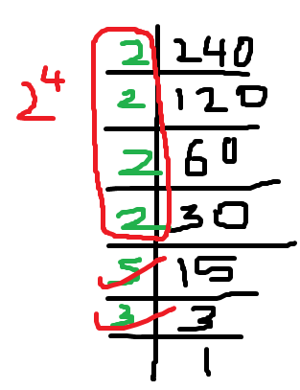
Euler’s Totient Function
Needs to be prime
ɸ(21) = ɸ(3) * ɸ(7)
= (3 - 1) * (7 - 1)
= 2 * 6 = 12
where the 12 integers are {1, 2, 4, 5, 8, 10, 11, 13, 16, 17, 19, 20}.
ɸ(240)
= ɸ(2⁴ * 5¹ * 3¹)
= ɸ(2⁴) * ɸ(5) * ɸ(3)
ɸ(p^{e}) = p^{e} - p^{e-1}
= (2⁴ - 2³) * (5 - 1) * (3 - 1)
= (16 - 8) * 4 * 2
= 8 * 8 = 64

Slide 68
Euler’s Theorem
Above equation is true if n is prime, because in that case, ɸ(n) = (n - 1) and Fermat’s theorem holds.
Consider the set of such integers, labeled as
R = {x1, x2, c, xf(n)}
That is, each element xi of R is a unique positive integer less than n with gcd(xi , n) = 1.
Now multiply each element by a, modulo n:
S = {(ax1 mod n), (ax2 mod n), c, (axf(n) mod n)}
For every ‘a’ and ‘n’ that are relatively prime
a^{ɸ(n)} ≡ 1 (mod n)

Slide 69


Euler’s Theorem
The set S is a permutation of R:
1. Because a is relatively prime to n and x_{i} is relatively prime to n, ax_{i} must also be relatively prime to n. Thus, all the members of S are integers that are less than n and that are relatively prime to n.
2. There are no duplicates in S. If ax_{i} mod n = ax_{j} mod n, then x_{i} = x_{j} .

Slide 70
Euler’s Theorem
Example:
1. If a = 3; n = 10; ɸ(10) = 4,
a^{ɸ(n)} = 3⁴ = 81 = 1 (mod 10) = 1 (mod n)
2. a = 2; n = 11; ɸ(11) = 10,
a^{ɸ(n)} = 2¹⁰ = 1024 = 1 (mod 11) = 1 (mod n)

